Slide 1
THE RELATIONAL DATABASE MODEL(1)
Database Concepts
Spring 2021
Week 4

Slide 2
A Logical View of Data
Facilitated by the creation of data relationships based on a logical construct called a relation
Relational database model enables logical representation of the data and its relationships
Logical simplicity yields simple and effective database design methodologies

Slide 3
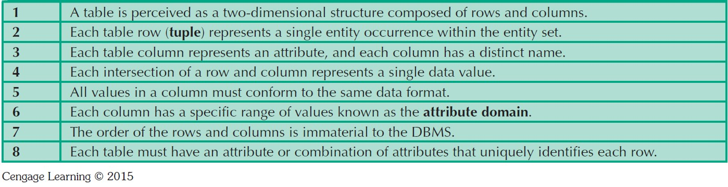
Table 3.1 - Characteristics of a Relational Table
Notes:
A table contains a group of related entity occurrences--each table represents an entity set.

Slide 4
Notes:
The STUDENT table is perceived to be a two-dimensional structure composed of eight rows (tuples) and 12 columns (attributes).
Each row in the STUDENT table describes a single entity occurrence within the entity set.
Each column represents an attribute, and each column has a distinct name.
All of the values in a column match the attribute’s characteristics. The column’s range of permissible values is known as its domain.
The order of rows and columns is unimportant to the user.
Each table must have a primary key.

Slide 5
General Data Types (1)
CHAR (L)
Character string. Fixed-length L.
CHAR(10)：always reserves 10 characters for variable the and is used for fixed-length size variable.
If you assign a value to a CHAR(L) column containing fewer characters than the defined length, the remaining space is filled with blanks characters.
VARCHAR (L)
Character string. Variable length. Maximum length L.
VARCHAR(10): can hold up to 10 characters for variable the and is used for variable-length size variable.
E.g.
Create table temp (City CHAR(10), Street VARCHAR(10));
Insert into temp
values ('Pune','Oxford');
select length(city), length(street) from temp;
Output will be:
length(City) Length(street) 10 6
Notes:
Char (l) defines the string length.
Use char when the sizes of the column data entries are consistent.
Use varchar when the sizes of the column data entries vary considerably.

Slide 6
General Data Types (2)
INT
A normal-sized integer that can be signed or unsigned.
If signed, the allowable range is from -2147483648 to 2147483647. If unsigned, the allowable range is from 0 to 4294967295.
TINYINT: -128 to +127 / 0 to 255 (unsigned)
SMALLINT: -32,768 to +32,767 / 0 to 65,535 (unsigned)
MEDIUMINT: -8,388,608 to 8,388,607 / 0 to 16,777,215 (unsigned)
BIGINT: -9,223,372,036,854,775,808 to 9,223,372,036,854,775,807 / 0 to 18,446,744,073,709,551,615 (unsigned)
Notes:
The "unsigned" types are only available in MySQL, and the rest just use the signed ranges, with one exception: tinyint in SQL Server is unsigned and has a value range of 0 to 255.

Slide 7
General Data Types (3)
DECIMAL (P, S)
The precision (P) is a positive integer that indicates the total number of digits (not including the decimal point).
The scale (S) is a positive integer that indicates the number of digits that represents decimal places to the right of the decimal point (the number of digits in the fractional part).
The scale for a DECIMAL cannot be larger than the precision.
Decimal(10,3) is a number that has 7 digits before the decimal and 3 digits after the decimal.
If you exceed the number of digits expected to the left of the decimal point, an error is thrown. If you exceed the number of expected digits to the right of the decimal point, the extra digits are truncated.
DECIMAL (10,3) 1234567.999
Valid:
1234567
1234567.123
1234567.1234 (Final digit is truncated)
-1234567
-1234567.123
-1234567.1234 (Final digit is truncated)
Invalid:
12345678
12345678.12
12345678.123
-12345678
-12345678.12
-12345678.123

Slide 8
General Data Types (4)
BOOLEAN
supports the storage of two values: TRUE or FALSE. (Not Yes nor No!)
DATE
Stores year, month, and day values. “YYYY-MM-DD”
TIME
Stores hour, minute, second values. “HH:MM:SS”
ENUM
An enumeration. When defining an ENUM, you are creating a list of items from which the value must be selected.
e.g.) ENUM (‘A’,‘B’,‘C’)

Slide 9
Determination
State in which knowing the value of one attribute makes it possible to determine the value of another
Is the basis for establishing the role of a key
Based on the relationships among the attributes

Slide 10
Dependencies
Functional dependence: Value of one or more attributes determines the value of one or more other attributes
Determinant: Attribute (Keys) whose value determines another Dependent: Attribute whose value is determined by the other attribute
Example: PROJ_NUM --> PROJ_NAME
(read as PROJ_NUM functionally determines PROJ_NAME)
In this case, the attribute PROJ_NUM is known as the determinant attribute, and the attribute PROJ_NAME is known as the dependent attribute.

Slide 11
Functional Dependencies
Full functional dependence: Entire collection of attributes in the determinant is necessary for the relationship
e.g. Full functional dependency occur when attribute is functionally dependent on a composite key
(First_name, Last_name) → GPA
Partial dependency: A dependency based on only a part of a composite primary key
Exist when there is a functional dependence in which the determinant is only part of the primary key
If (A, B) → (C, D); (A, B) is the primary key, then the functional dependence B → C is a partial dependency because only part of the primary key (B) is needed to determine the value of C.

Slide 12
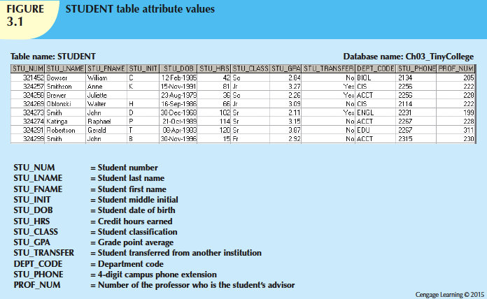
Notes:
If you are given a value for STU_NUM, then you can determine the value for STU_LNAME because one and only one value of STU_LNAME is associated with any given value of STU_NUM. Here it would be correct to say that STU_NUM is the determinant and STU_LNAME is the dependent.
This means one name is associated with that STU number.
The standard notation for representing the relationship between STU_NUM and STU_LNAME is as follows: STU_NUM → STU_LNAME

Slide 13
Types of Keys
Key: an attribute or group of attributes that can determine the values of other attributes. E.g., Super key, primary key, etc.
Composite key: a key that is composed of more than one attribute. ( flight # and date) (bridge entityp1)
▪▪ Null: Absence of any data value that could represent:
▪▪ An unknown attribute value
▪▪ A known, but missing, attribute value
▪▪ An inapplicable condition
Primary keys are “NN”!
Notes:
A null is the absence of any data value, and it is never allowed in any part of the primary key. a null could represent any of the following:
• An unknown attribute value
• A known, but missing, attribute value
• A “not applicable” condition
Composite can be a group of attributes

Slide 14
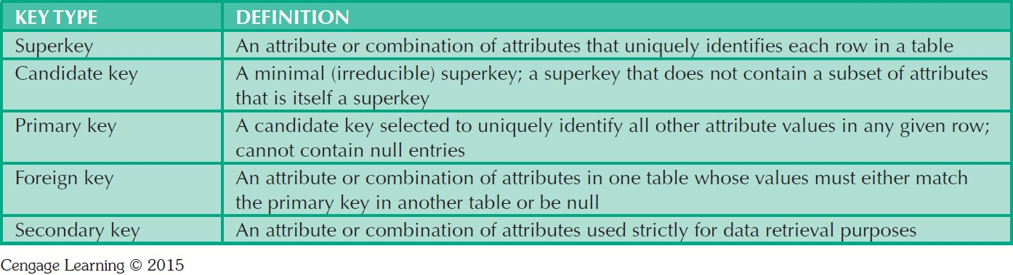
Table 3.3 - Relational Database Keys

Slide 15
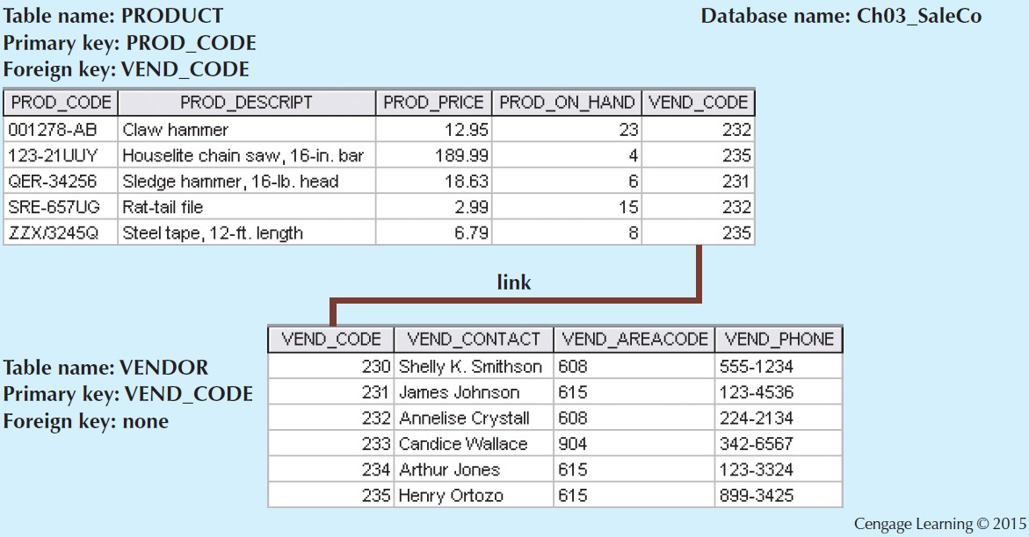
Figure 3.2 - An Example of a Simple Relational Database
Notes:
The PRODUCT table contains a foreign key, PROD_CODE, that links records in the PRODUCT table to the VENDOR table. VEND_CODE entries in the PRODUCT table all match the VEND_CODE entries in the VENDOR table.

Slide 16
Superkey, Candidate key, Primary key
Super Keys : A Super Key is a set of one or more attributes that can identify all other attributes uniquely.
So in this table we can have the following as our Super key. Each super key is able to uniquely identify each tuple (record).
Candidate Keys: Candidate keys are a super key which are not having any redundant attributes. In other words candidate keys are minimal super keys.
These two keys can be candidate keys, as remaining keys are having redundant attributes.
Primary Key: It is a candidate key that is chosen by the database designer to uniquely identify each record. From above Candidate keys any one can be the primary key. And the another one which is not chosen as primary key will be know as Alternate key.

Slide 17
Integrity Rules*****
Entity integrity: Condition in which each row in the table has its own unique identity
Every table must have a primary key.
A primary key cannot be NULL.
Referential integrity: Mechanism the system provides to maintain foreign keys
A foreign key must have matching values in the primary key of another table.
Notes:
RDBMSs enforce integrity rules automatically. However, it is important to make sure that we ( as a database designers ) do not violate these rules.

Slide 18
Integrity Rules
Entity Integrity | Description
Requirement | All primary key entries are unique, and no part of a primary key may be null
Purpose | Each row will have a unique identity, and foreign key values can properly reference primary key values
Example | No invoice can have a duplicate number, it cannot be null

Slide 20
Integrity Rules
Referential Integrity | Description
Requirement | A foreign key may have either a null entry or a entry that matches a primary key value in a table to which it is related
Purpose | It is possible for an attribute not to have a corresponding value but it is impossible to have an invalid entry It is impossible to delete row in a table whose primary keys has mandatory matching foreign key values in another table
Example | It is impossible to have invalid agent number in customer table

Slide 21
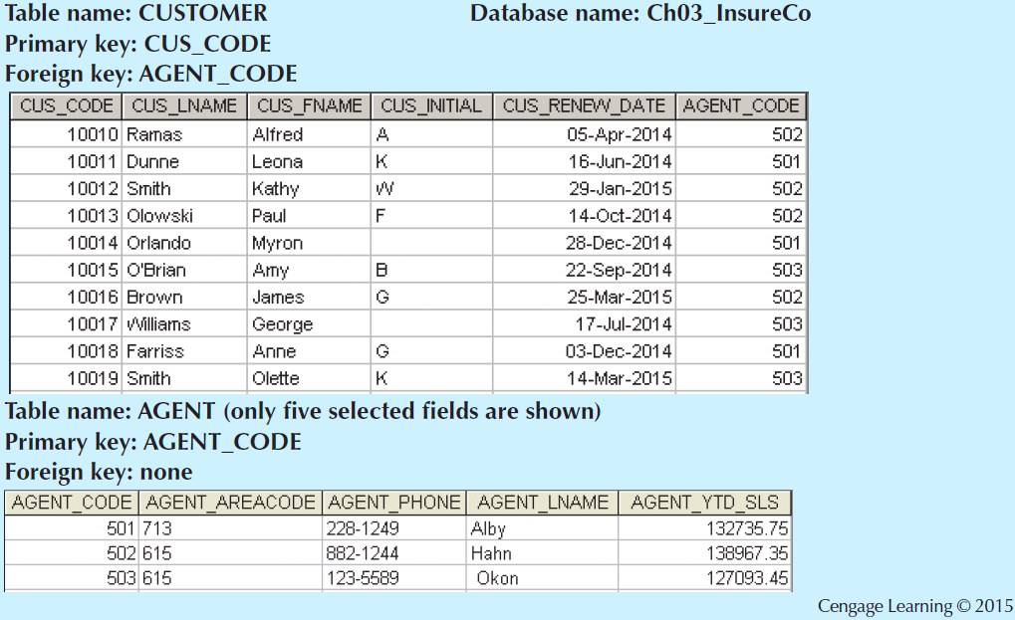
Fig 3.3 - An Illustration of Integrity Rules
Notes:
Entity integrity. The CUSTOMER table’s primary key is CUS_CODE. The CUSTOMER primary key column has no null entries, and all entries are unique. Similarly, the AGENT table’s primary key is AGENT_CODE, and this primary key column is also free of null entries.
Referential integrity. The CUSTOMER table contains a foreign key, AGENT_CODE, that links records in the CUSTOMER table to the AGENT table. AGENT_CODE entries in the CUSTOMER table all match the AGENT_CODE entries in the AGENT table.

Slide 22
